Slide 1
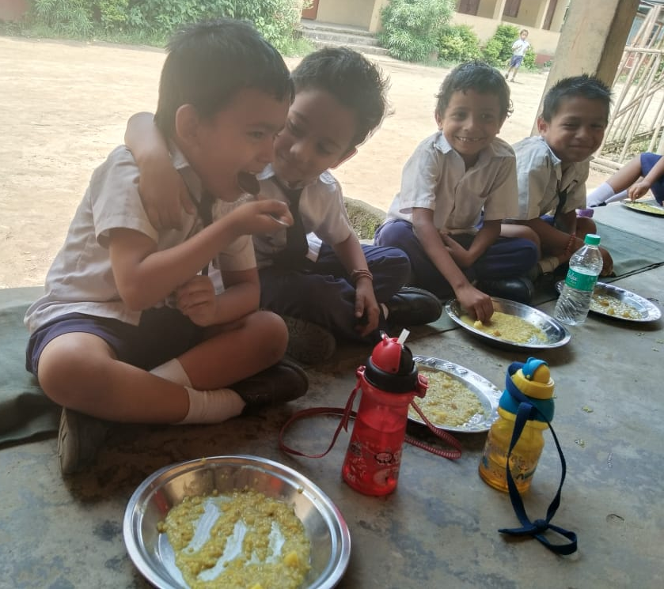
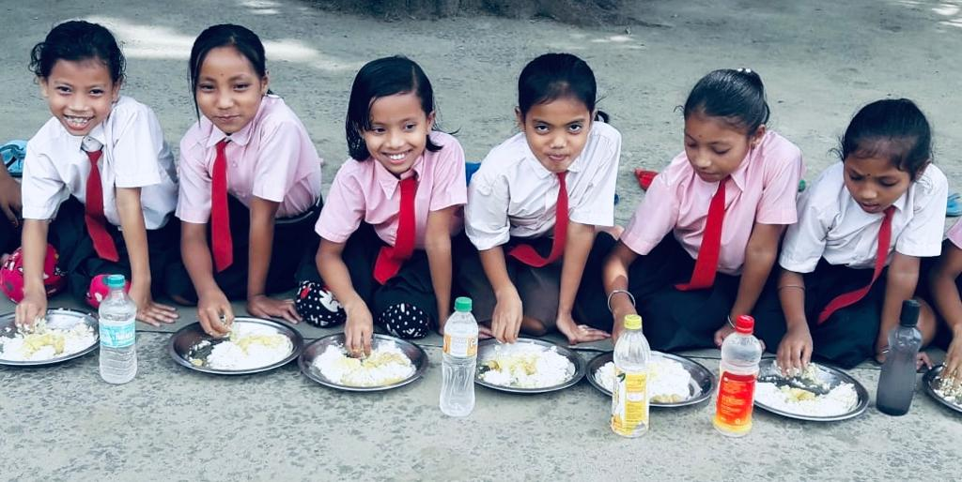
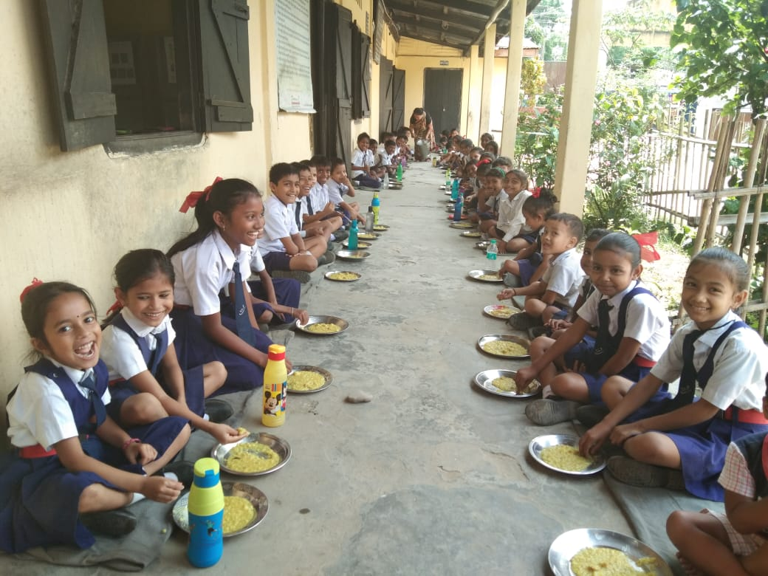
A brief presentation on Best Practices under Mid-Day-Meal Scheme (MDMS), Assam

Slide 2
Best Practices

Slide 3
Best Practices
The Best Practices
MDMS, Assam
School Nutrition Garden
Multi tap Hand Washing Facility
MDM Calendar as Information Education Communication (IEC) Material
Sampriti Bhojan
Guideline on Food Safety and Hygiene for Kitchen

Slide 4
MDMS, Assam
MDMS, Assam
SCHOOL NUTRITION GARDEN
School Nutrition Garden is a source of fresh nutritious vegetables (leafy & green vegetable) for school feeding.
State has promoted School Nutrition Garden in schools with the help of School Managing Committees/Communities/Line Department.
School Nutrition Garden is an effective learning venue for students to increase their knowledge and learn more about vegetables and its uses.
School children also learn to appreciate conservation of nature, agricultural habits as well as the importance of vegetables for health and wellness.
School Nutrition Garden concept has been upscaled in schools during Gunotsav Programme in Assam.
Kitchen garden provides – Green leafy vegetables (Cabbage, Cauliflower, Kohlrabi), Radish, Carrot, Tomato, Ladies finger, Papaya, Bottle gourd, Pumpkin, Bean, Brinjal etc.
A photo album of School Nutrition Garden is placed before the Chairperson of PAB -MDM for kind perusal.

Slide 5
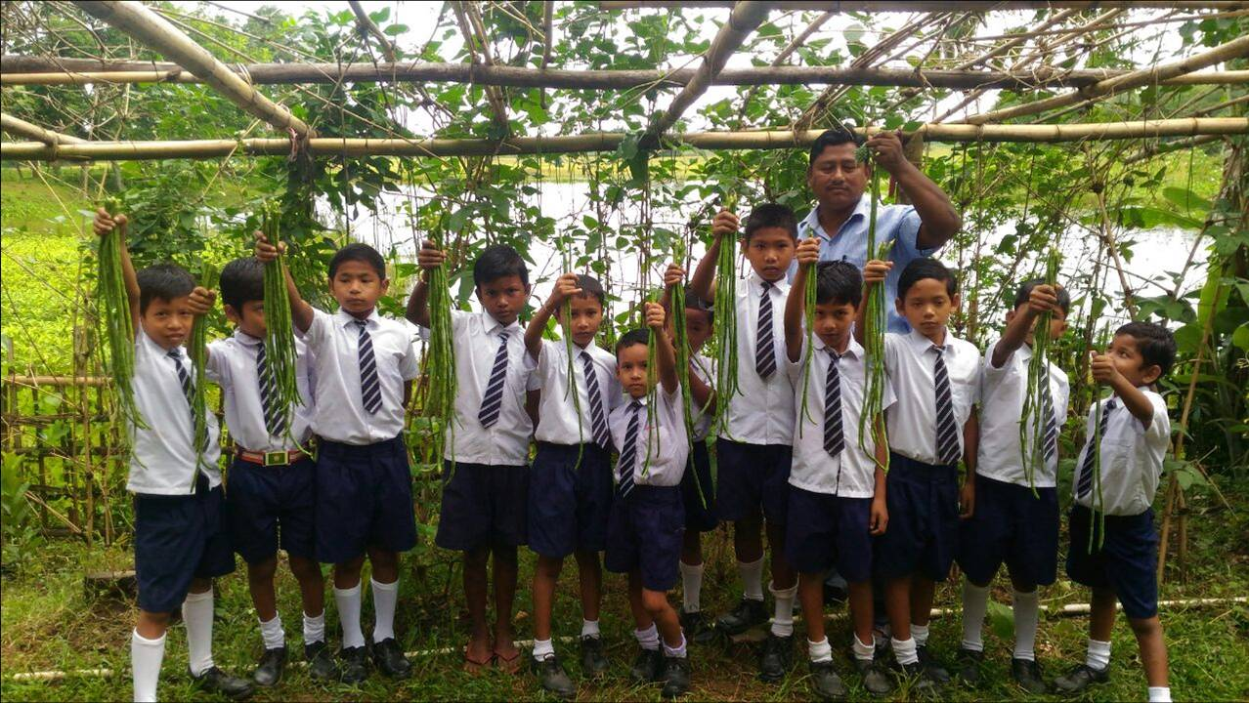
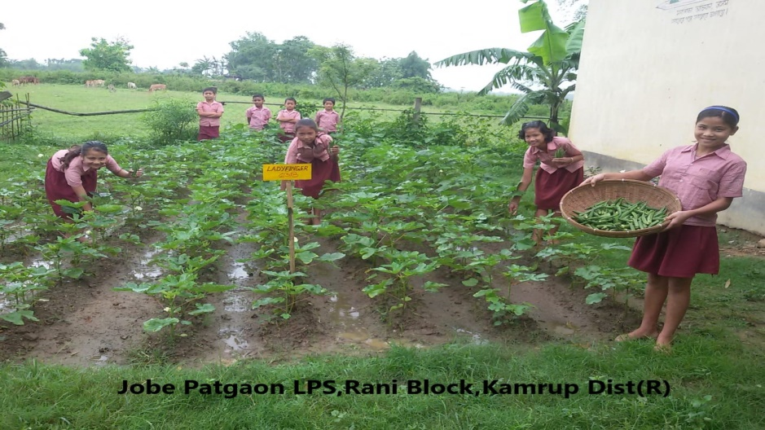
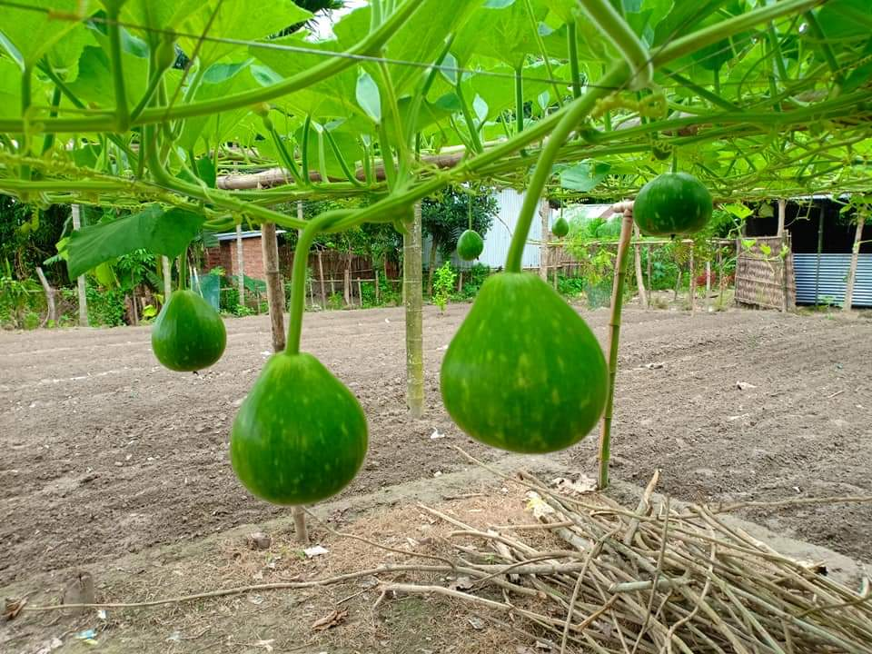
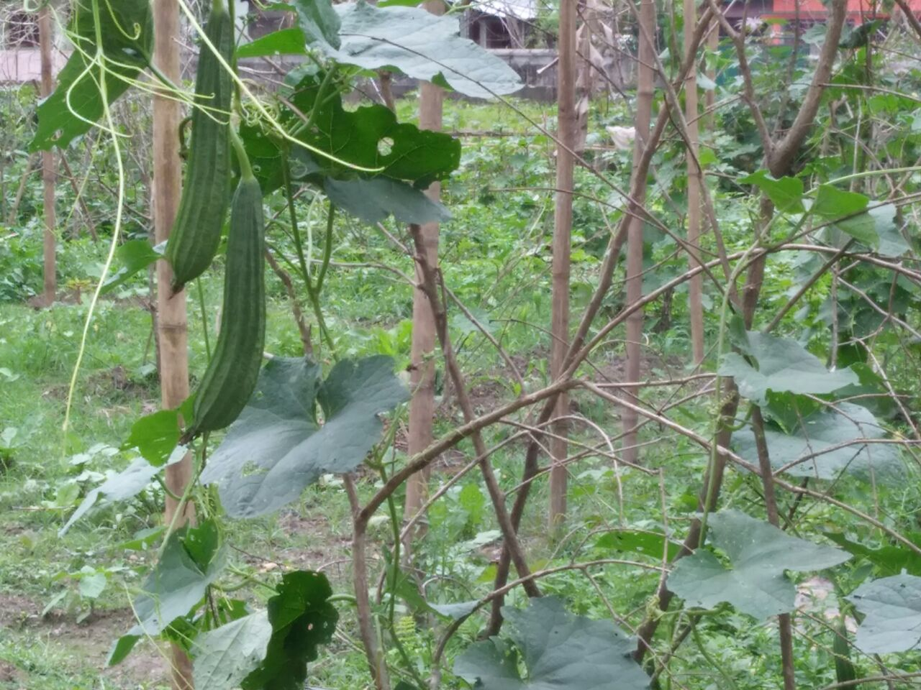
MDMS, Assam
Bean
Ladies finger
Bottle gourd
Ridge gourd/ Ridged luffa

Slide 6
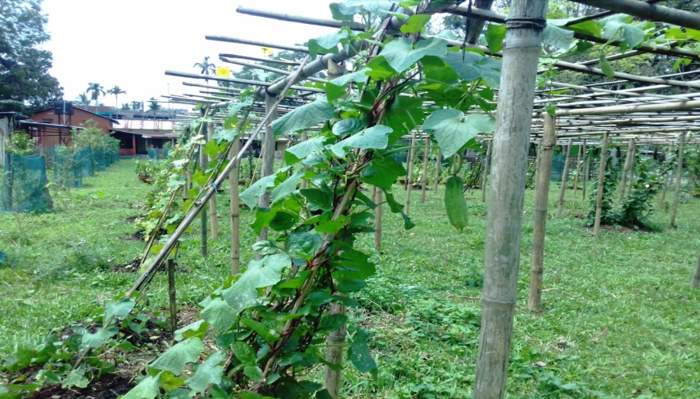
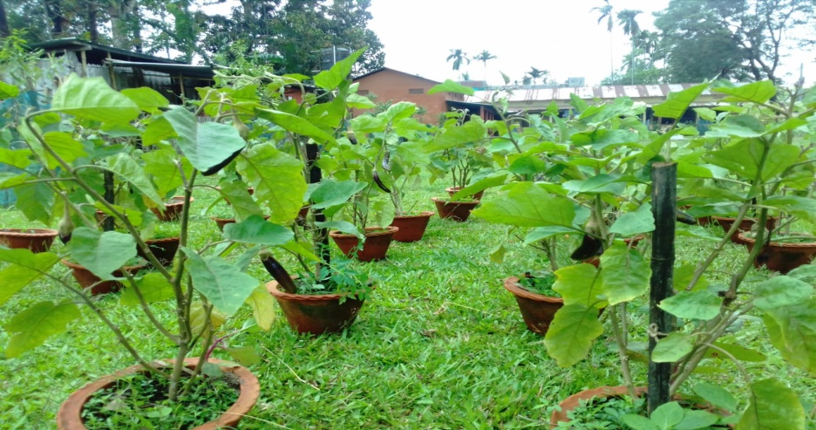
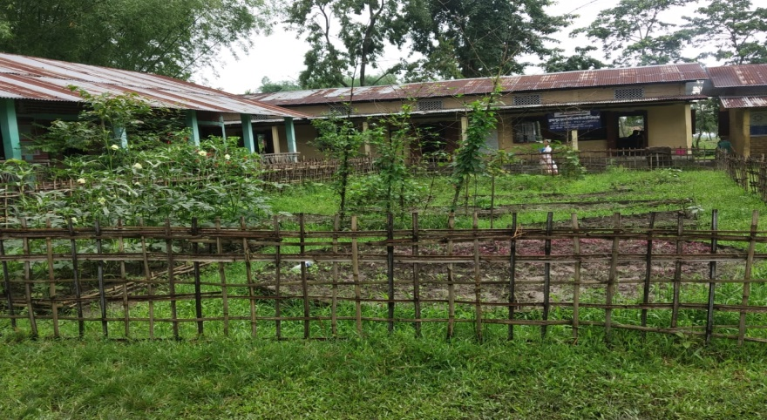
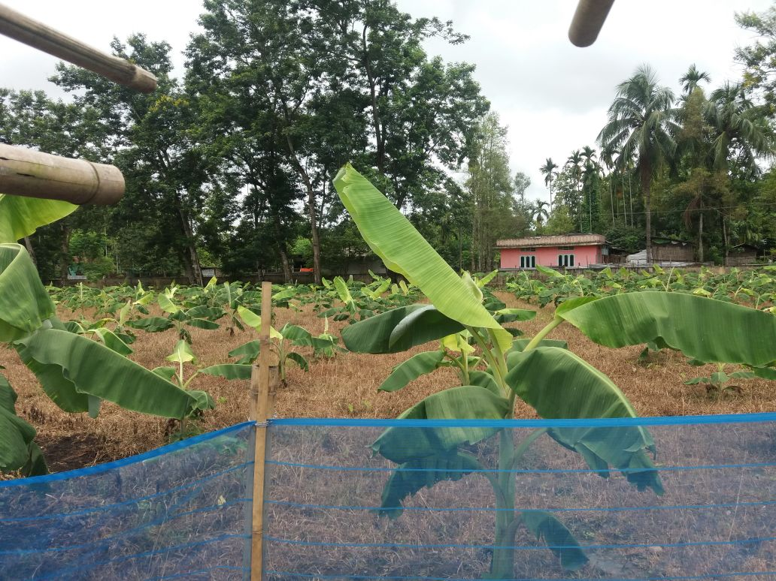
MDMS, Assam
Cucumber
Brinjal
Ladies finger
Banana

Slide 7
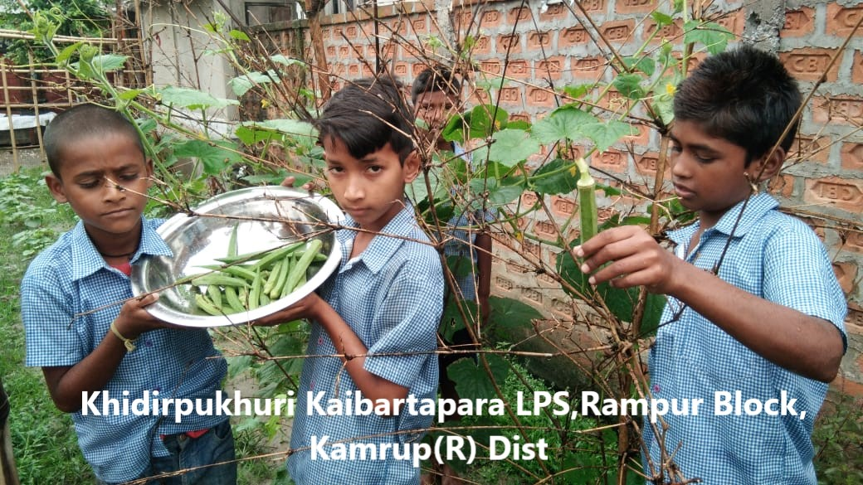
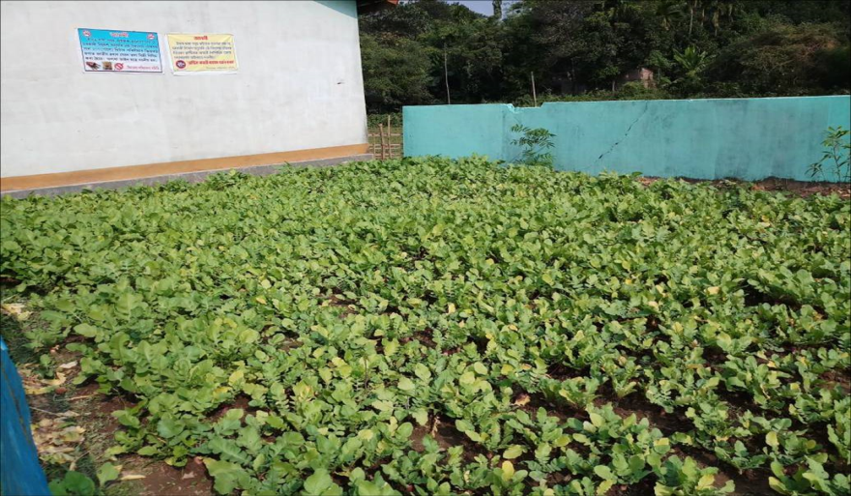
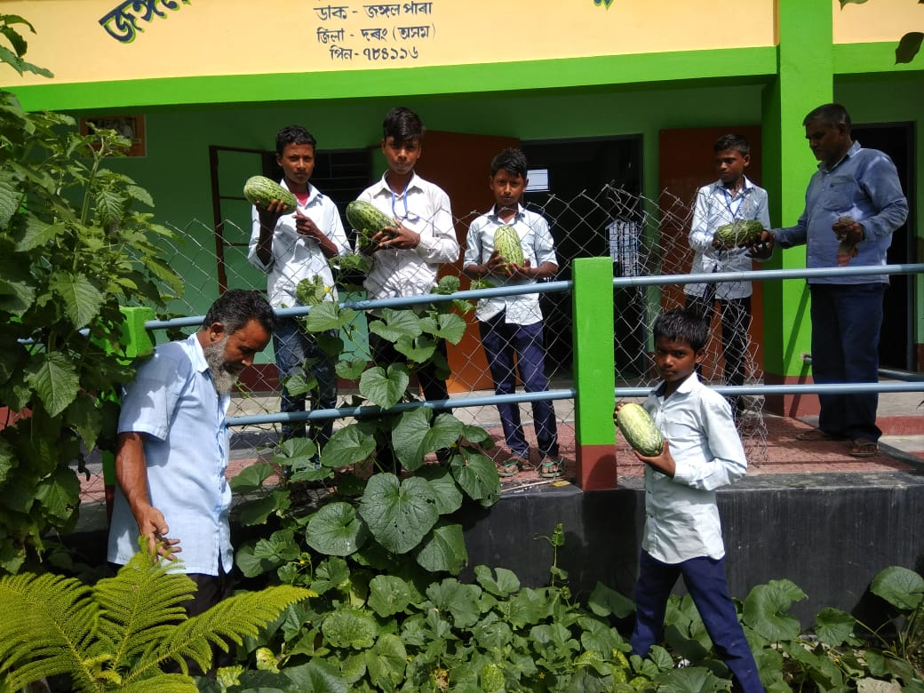
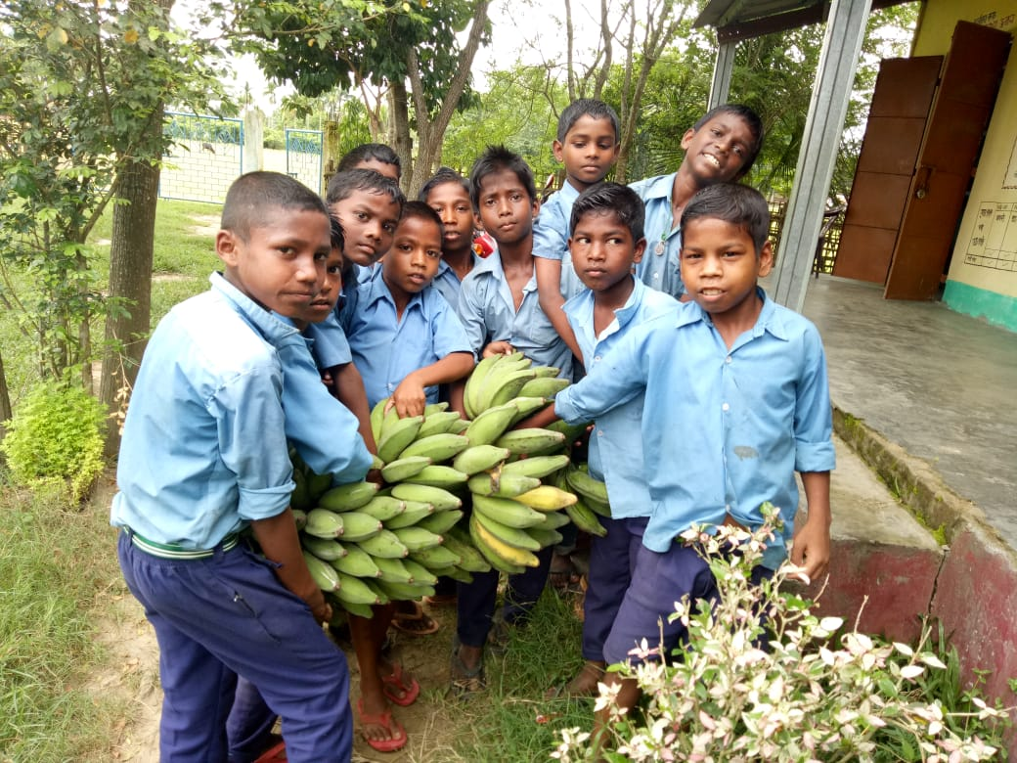
MDMS, Assam
Spinach and Radish
Ladies finger
Santa claus melon
Banana

Slide 8
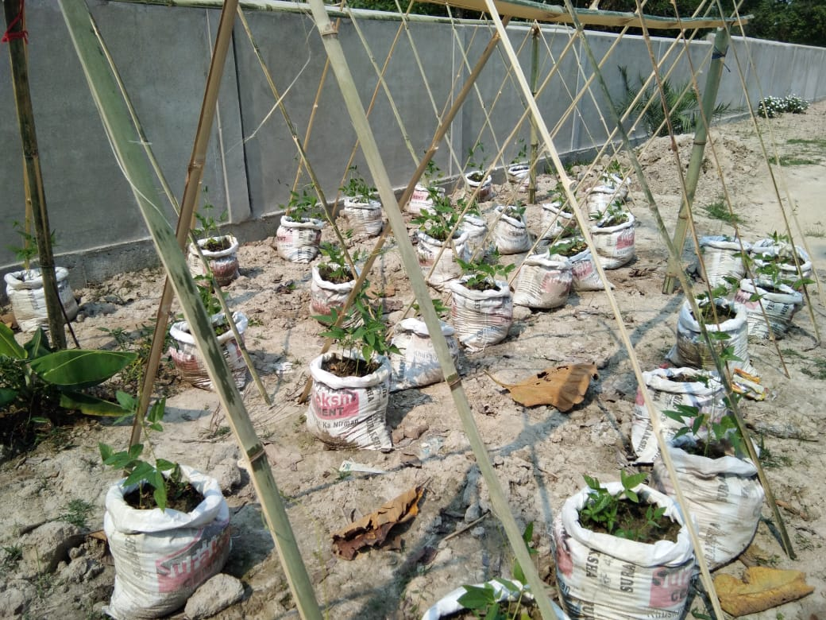
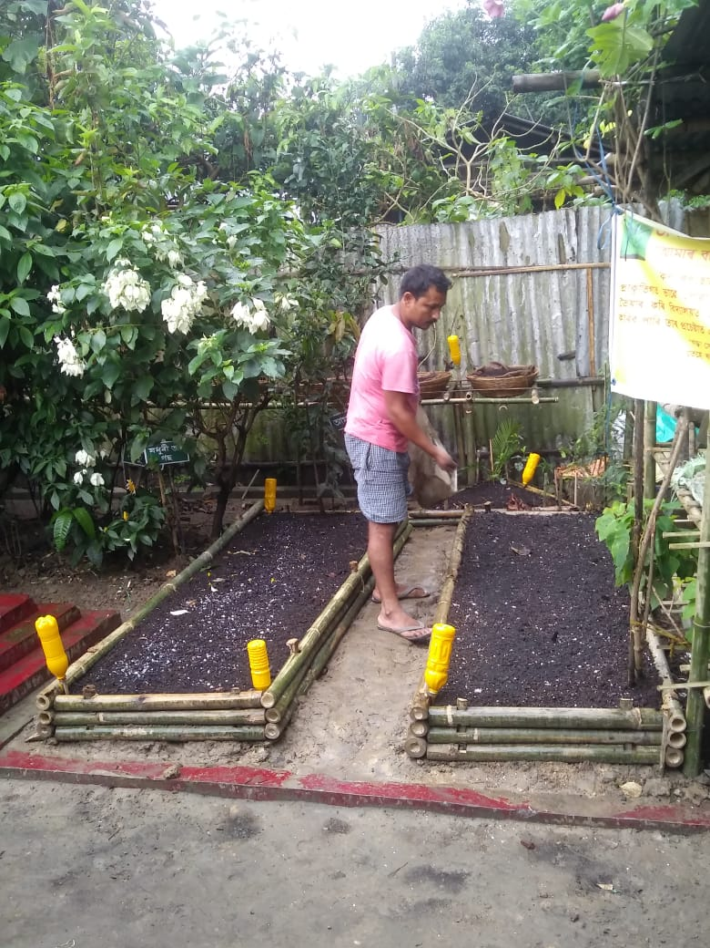
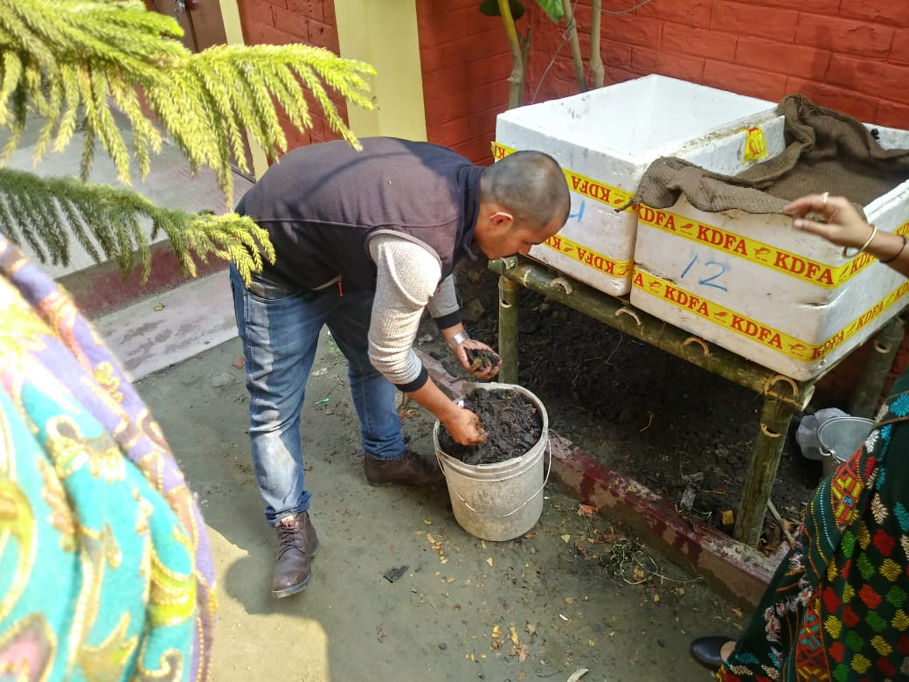
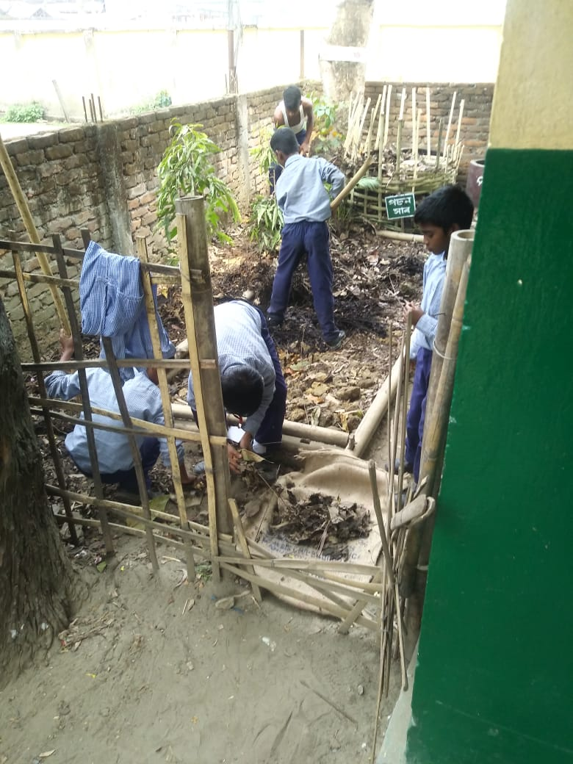
MDMS, Assam
Plantation at rice and sugar bags
Preparation of Organic manure
Preparation of Organic manure
Developing School Nutrition garden

Slide 9
MDMS, Assam
MDMS, Assam
Multi Tap Hand Washing Facility
Assam model of Group Hand-washing before and after Mid-Day-Meal is one of the best model in the country with low cost high value principle.
Total 422 schools of Rani, Rampur and Kamalpur blocks of Kamrup Rural district provided low cost Group Hand-washing facility with UNICEF support.
It has reduced the diseases like diarrhoea, skin disease etc.
Growing good habits from the early childhood stage.
Multi tap hand washing facility has been upscaled during the Gunotsav Programme.

Slide 10
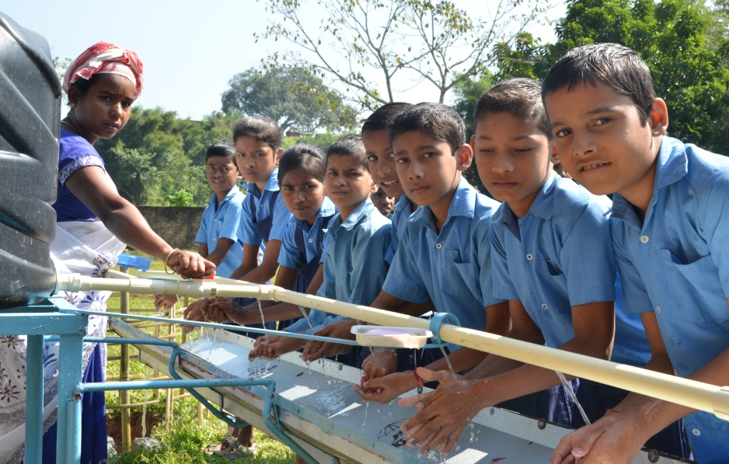
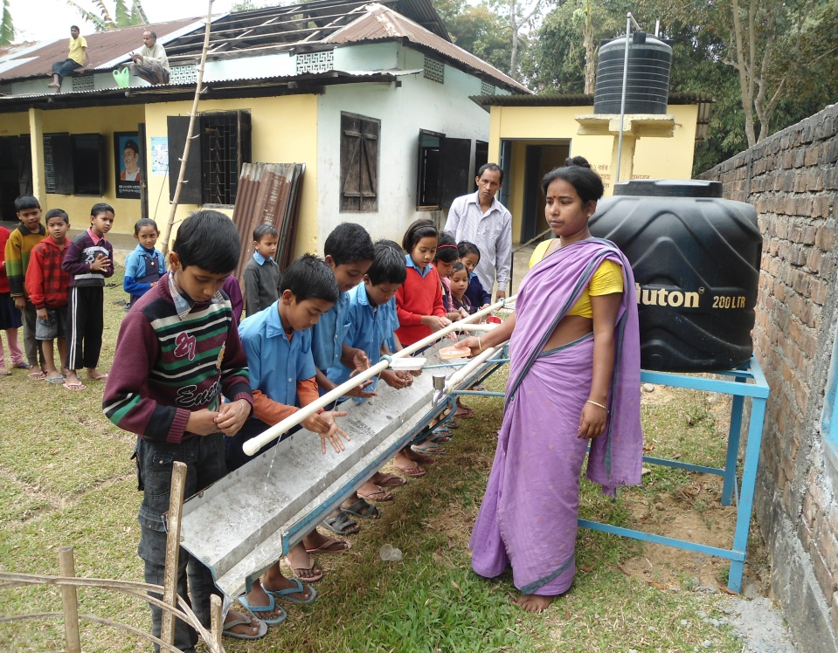
MDMS, Assam

Slide 11
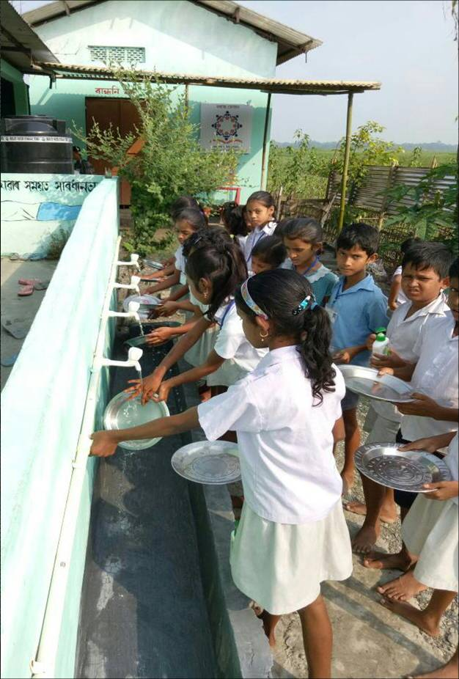
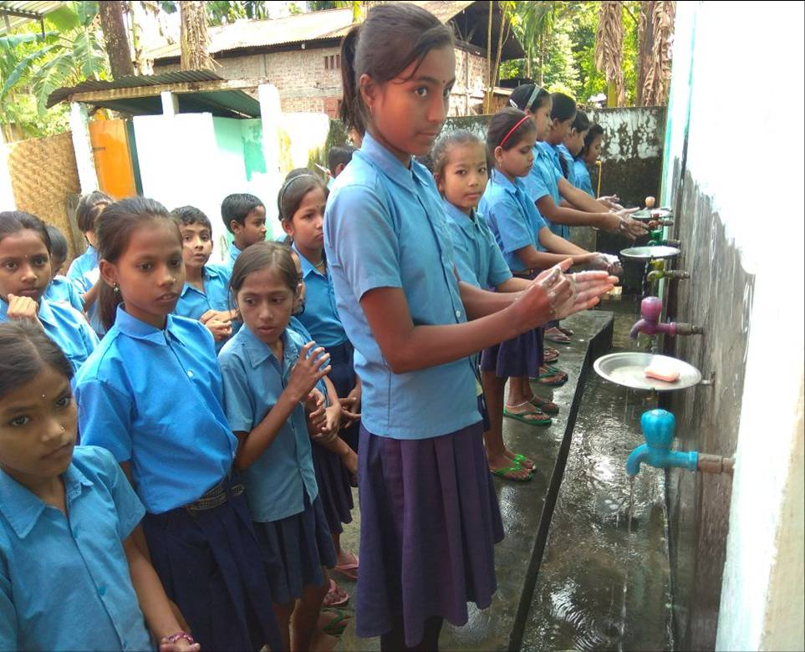
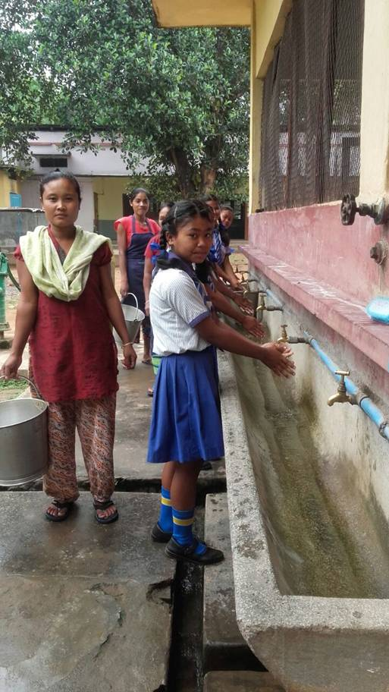
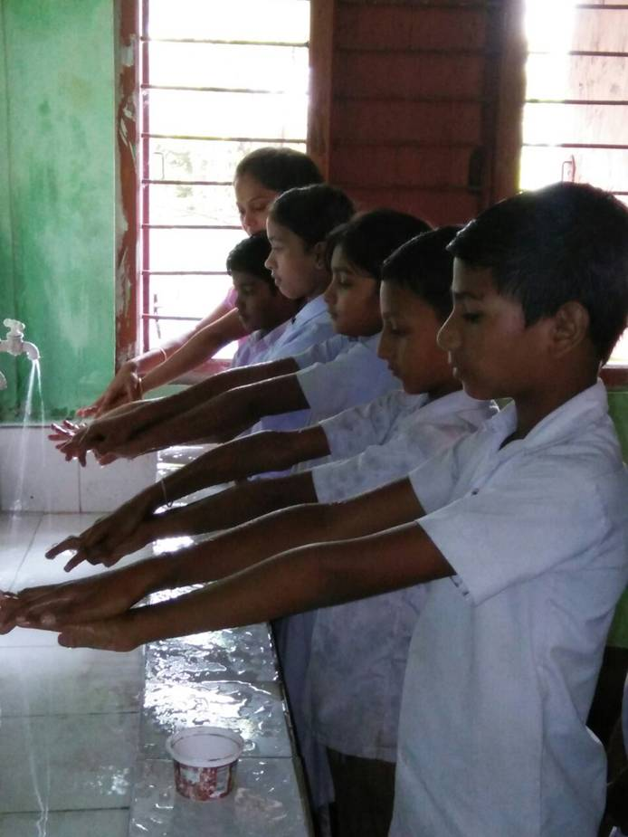
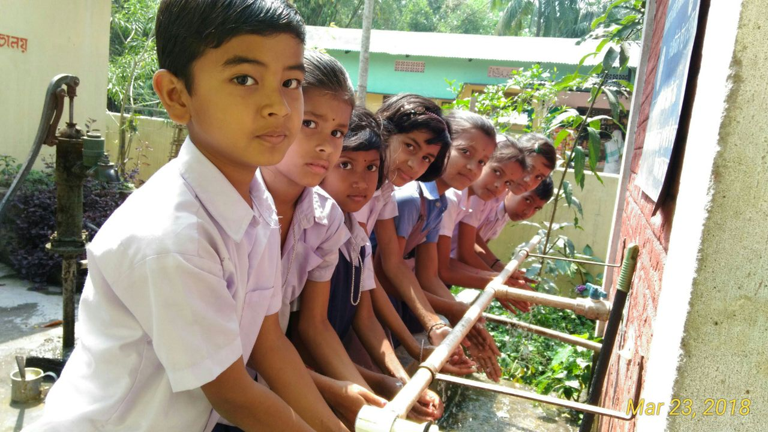
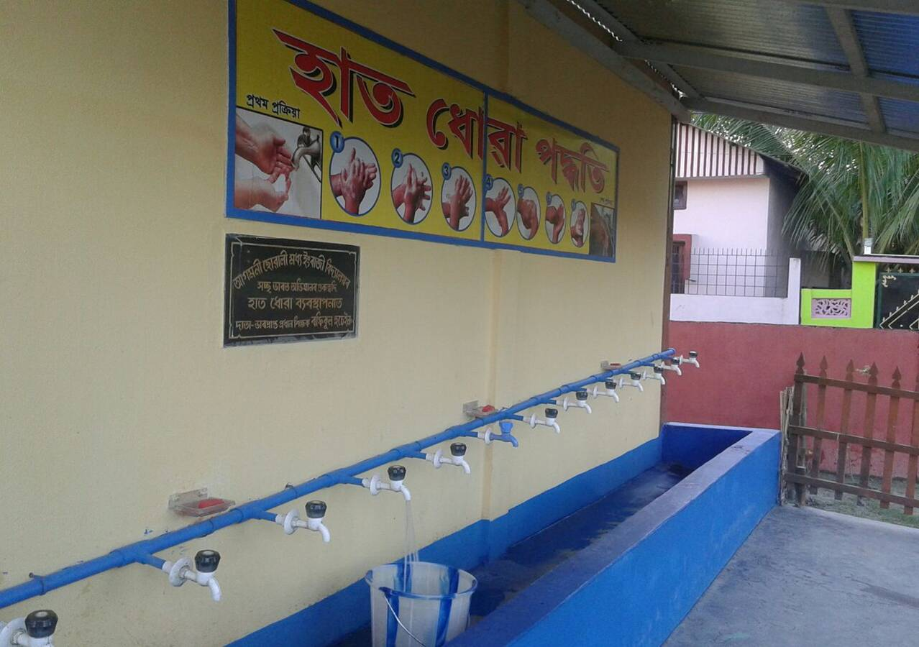
MDMS, Assam

Slide 12
MDMS, Assam
MDM Calendar as Information Education Communication (IEC) Material
State has provided MDM calendar as IEC material to all schools and offices of Education Department and district administration. Information like suggested weekly menu, calorie chart, norms in respect of all components (cooking cost, cost of food grains, transportation cost, days to be served MDM, food grains entitlement) displays in MDM Calendar. ‘MDM Rules, 2015’ and ‘Guideline of Sampriti Bhojan’ have been translated into Assamese language and displays in MDM Calendar. Calendar also displays best initiatives in the State through activity photographs portraying children of schools.

Slide 13
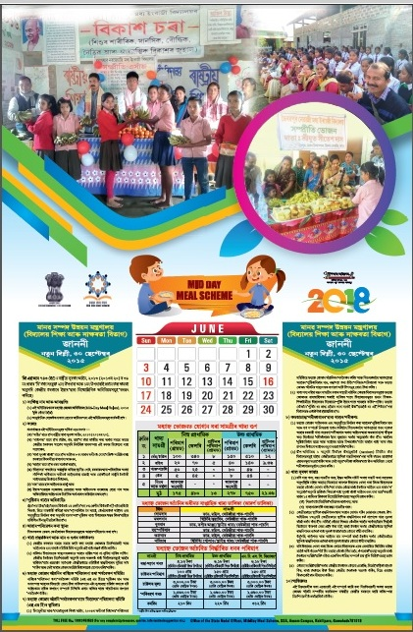
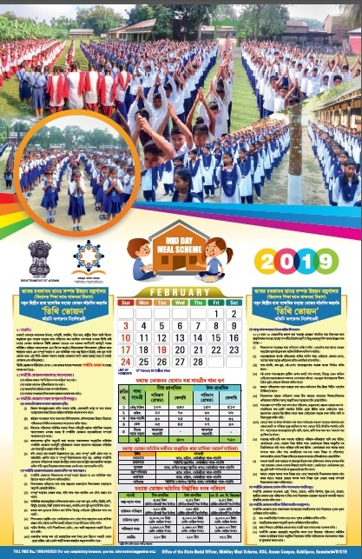
MDMS, Assam
MDM Calendar 2018
MDM Calendar 2019

Slide 14
MDMS, Assam
Sampriti Bhojan
State is implementing ‘Sampriti Bhojan Programme’ to encourage communities in the schools to benefit the children.
Members of community provides additional food items on special occasions i.e. Birthdays, Anniversaries, Festivals, Days of National importance etc.
During the programme, supplementary nutritive items like sweet, bread butter/ jam, egg, apple, banana, orange, chick pea, moong, milk, snacks, biscuits etc. are provided to the children of the schools in addition to Mid-Day Meal.
It is proposed to install hoarding on Sampriti Bhojan in prominent places of the districts to upscale the programme.
A photo album of Sampriti Bhojan is placed before the Chairperson of PAB -MDM for kind perusal.

Slide 15
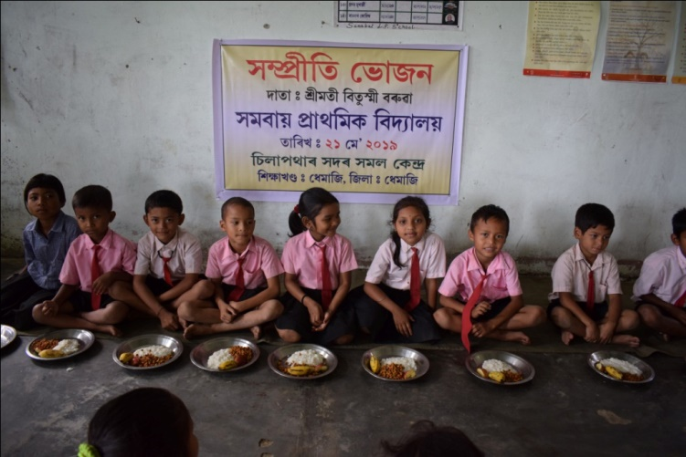
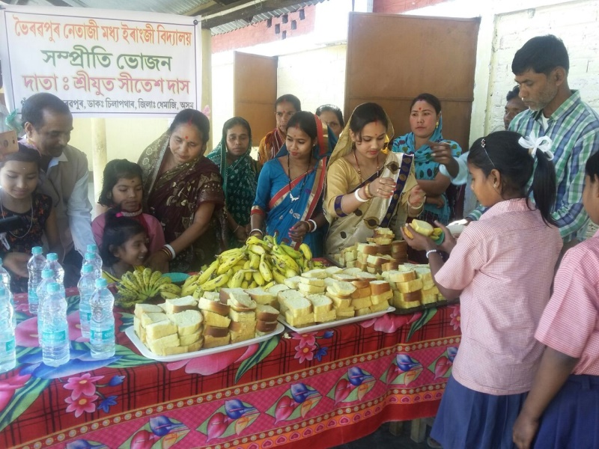
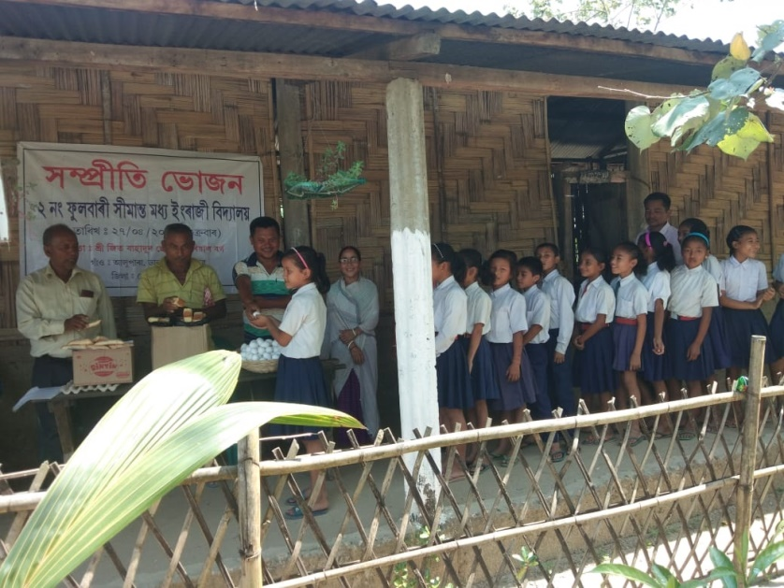
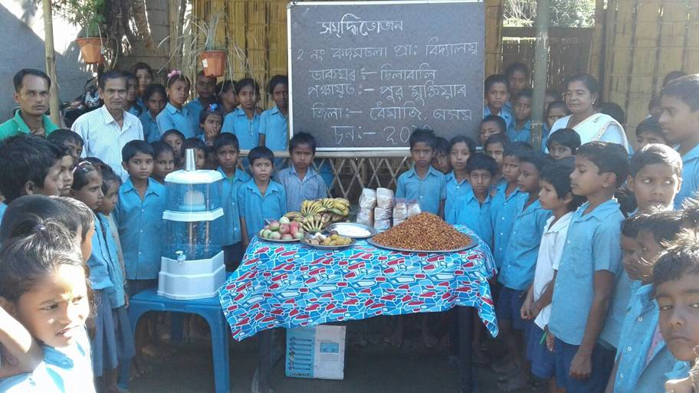
MDMS, Assam
Additional food items like Banana, Bread Butter/Jam, Chick pea, Sweets etc. distributed in Sampriti Bhojan

Slide 16
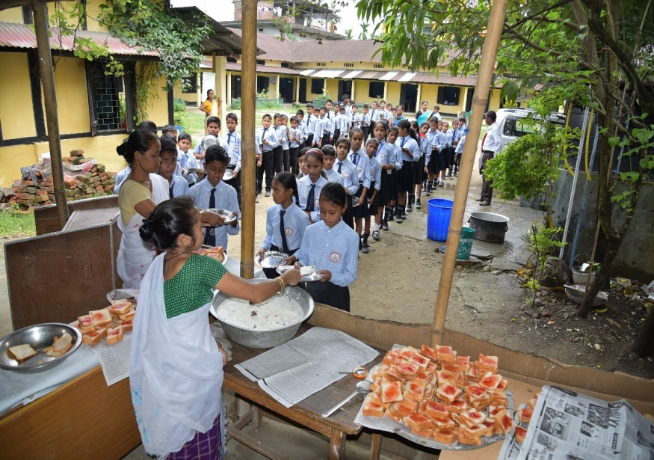
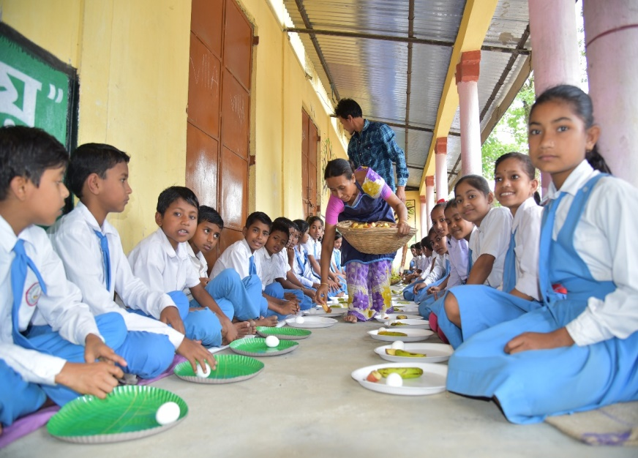
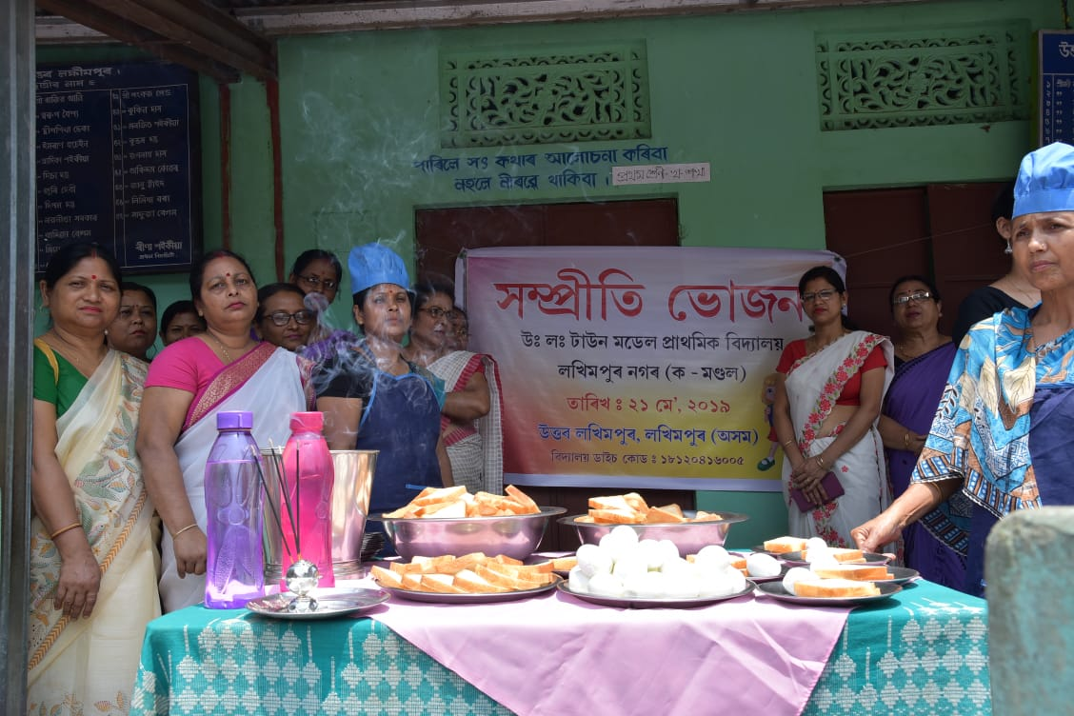
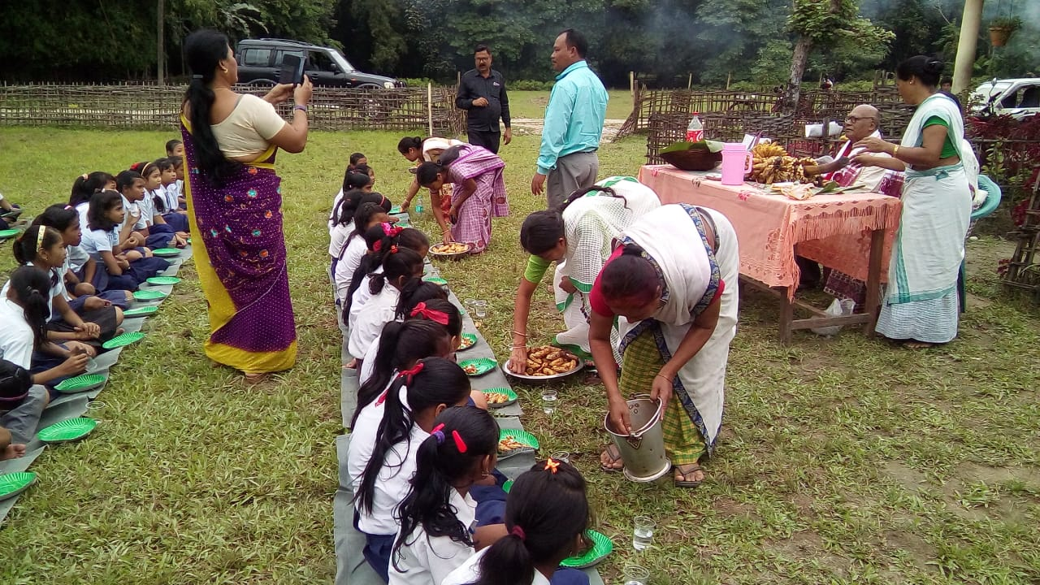
MDMS, Assam
Additional food items like Egg, Banana, Bread Butter/Jam, Chick pea, Sweets etc. distributed in Sampriti Bhojan

Slide 17
MDMS, Assam
Guideline on Sampriti Bhojan (Assamese language) is proposed to be made as Hoarding and to be installed in prominent places of the districts.

Slide 18
MDMS, Assam
Guideline on Food Safety and Hygiene for Kitchen
Guidelines on food safety and hygiene for school level kitchens under MDM Scheme have been translated into Assamese, Bengali and Bodo languages and distributed to all schools.
MDM Rules, 2015 have also been translated into Assamese, Bengali and Bodo languages and printed in the said booklet.
Training has been imparted to Cook cum Helpers, President & Member Secretary of the SMCs on food safety and hygiene for school level kitchens and MDM Rules, 2015.
‘MDM Rules, 2015’ and ‘Guideline of Sampriti Bhojan’ have been incorporated in the training module of SMC’s members under Samagra Shiksha.

Slide 19
MDMS, Assam
Assamese
Bengali

Slide 20
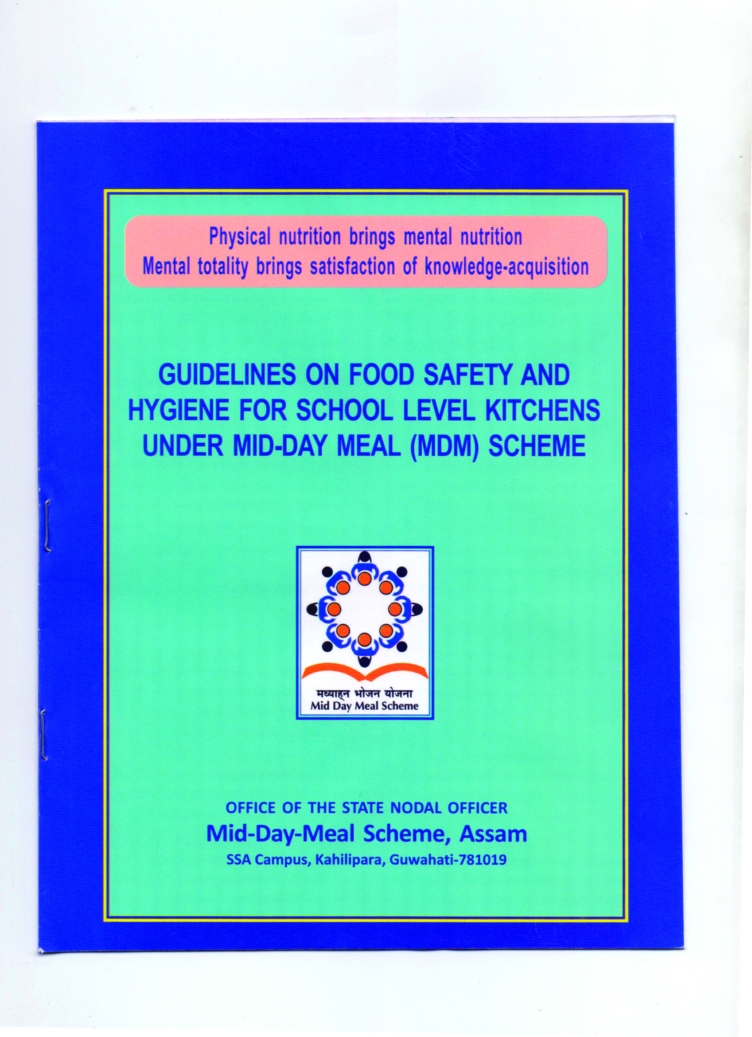
MDMS, Assam
Bodo
English

Slide 21
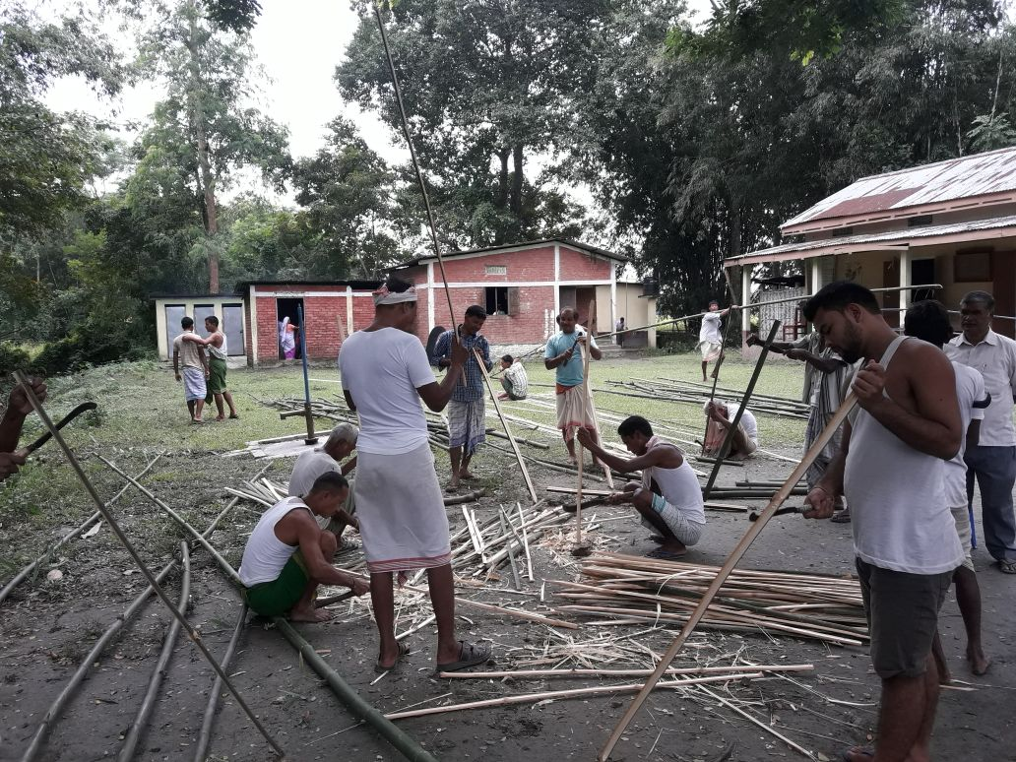
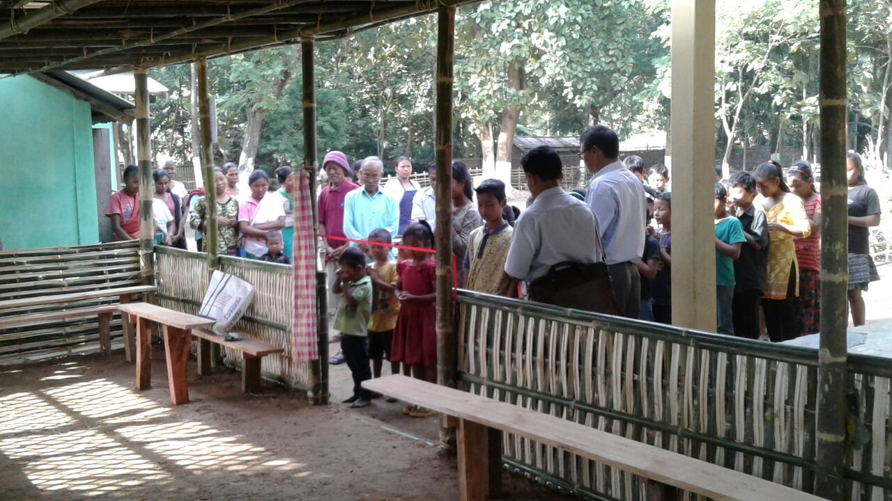
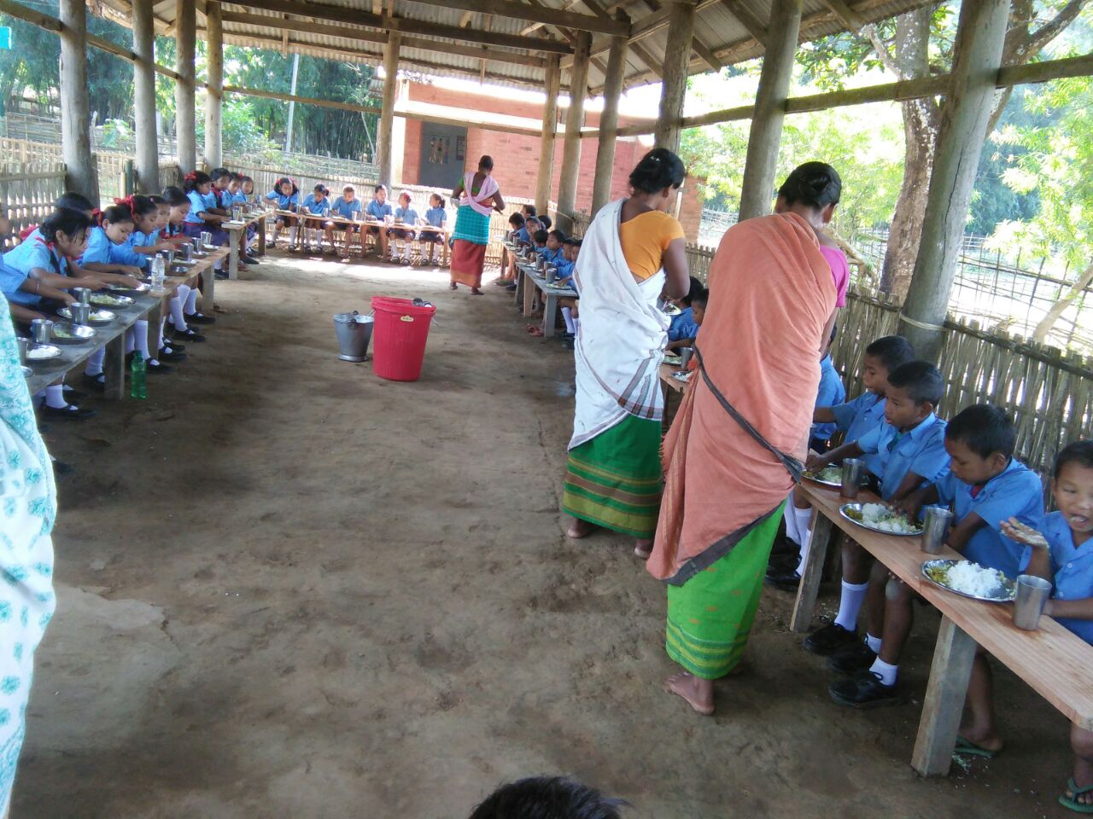
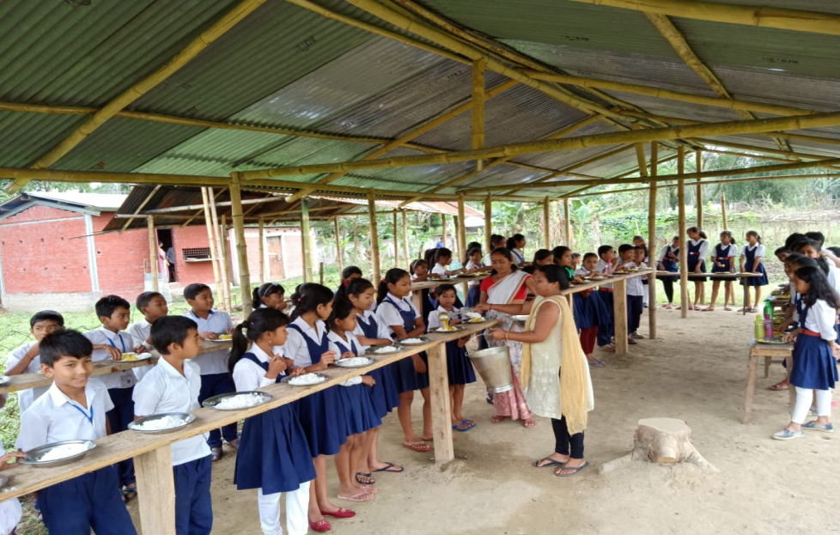
Innovation under MDMS, Assam
MDMS, Assam
Dining Hall developed by Community

Slide 22
MDMS, Assam
Cooking Competition under MDM Scheme
As per communication received from GOI vide letter No.F.no.1-4/2018-Desk (MDM) dated 28th February, 2019, Cooking Competition at various levels may be organized to promote innovative menu.
Cooking competitions under MDMS were held in three districts namely, Nalbari, Kamrup (Rural) and Dhemaji on 7th June, 2019 on experimental basis.
Three nearby schools of each district were selected for organizing the cooking competition. One school is selected as a venue for the competition and other two nearby schools were participated.
Officers from District and Block levels, Sub-Divisional Medical & Health Officer, Nutritional Expert cum Food Safety Officer, Members of SMC’s & Mother Groups, Teachers, Parents, Community were also present in the competition.
Children of all the participating schools, District officials of various levels/ Departments, Teachers, etc. have tasted the meals prepared by the Cook cum Helpers and have given their judgment accordingly.
Certificate of honour and token of appreciation were given to all the participating Cook cum Helpers.

Slide 23
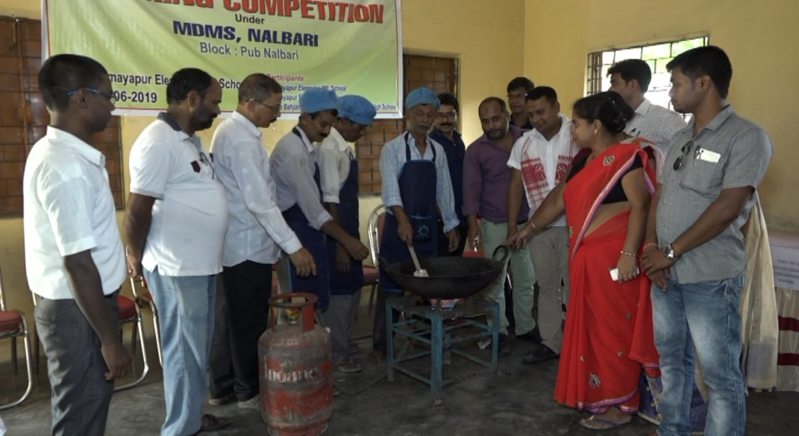
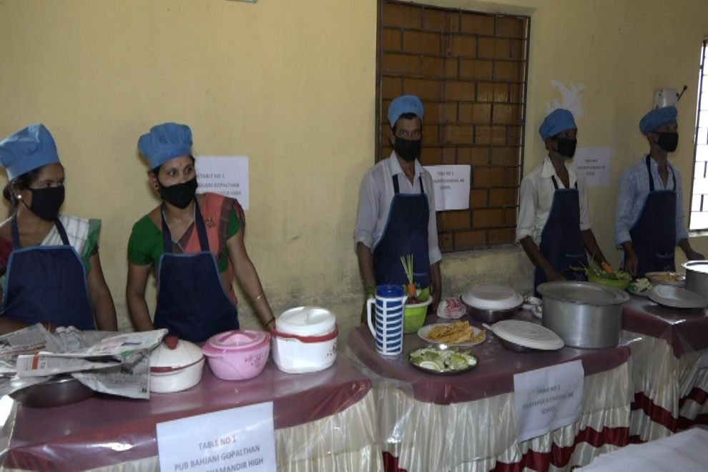
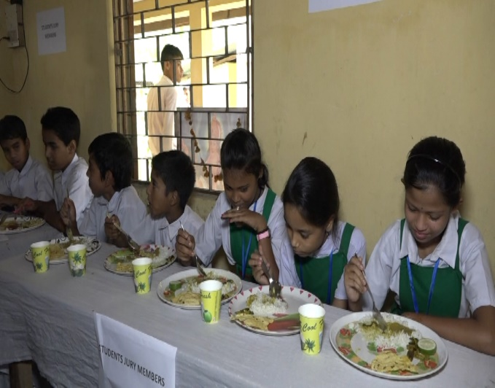
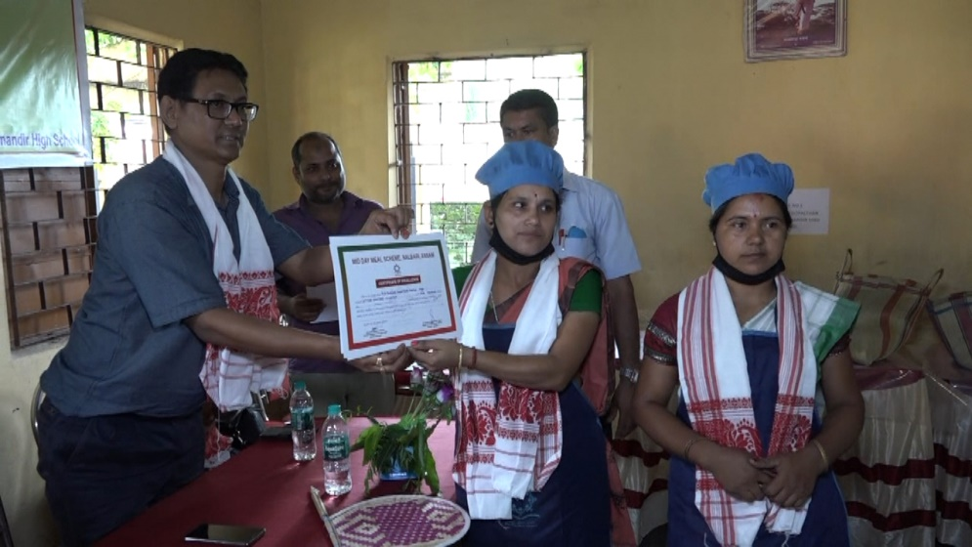
MDMS, Assam
Cooking Competition: Nalbari District
1. Pub Bahjani Gopalthan Balika Vidyapith High School, 2. Amayapur Elingidal ME School,
3. Amayapur Elingidal MV School, Cook cum Helpers participated- 6 ( 2 in each school)

Slide 24
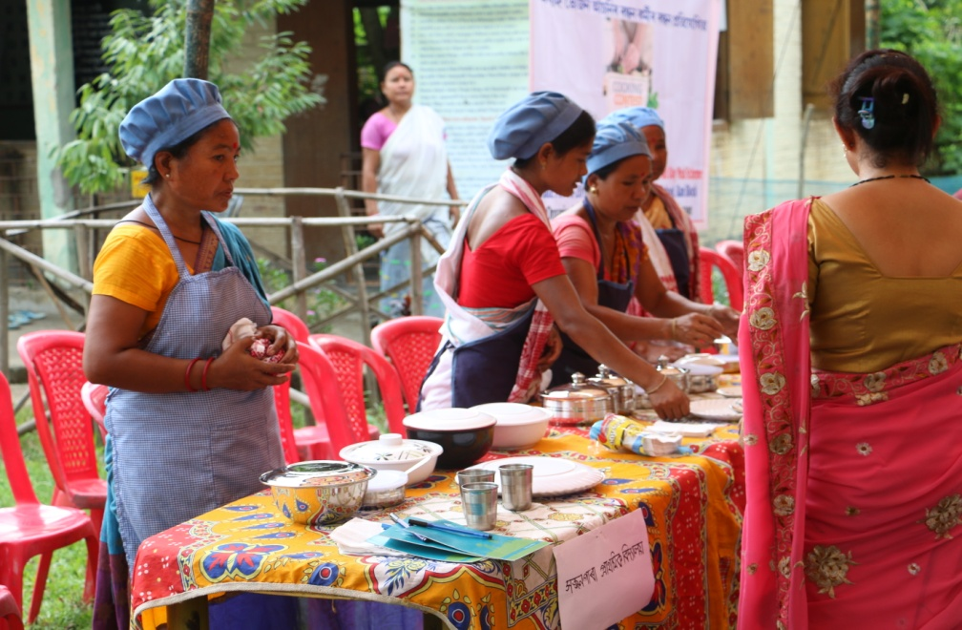
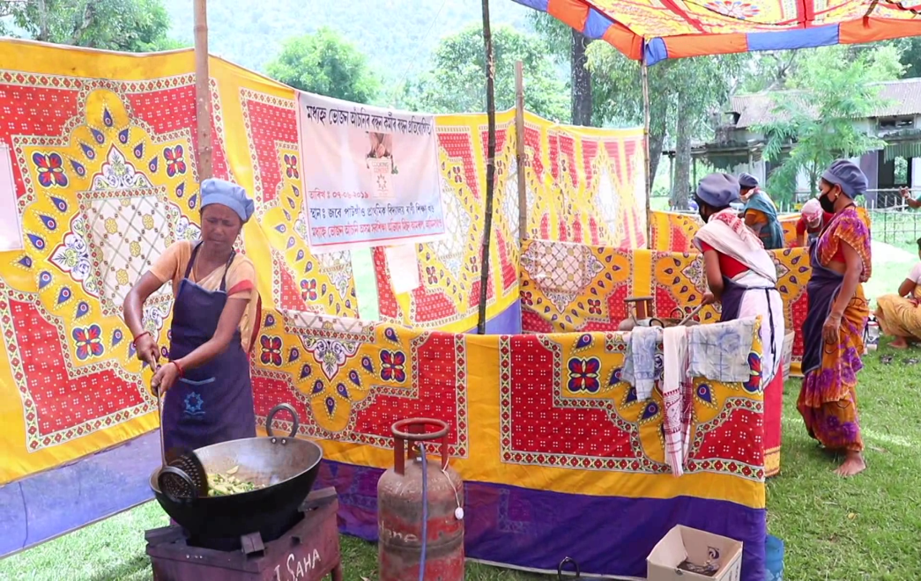
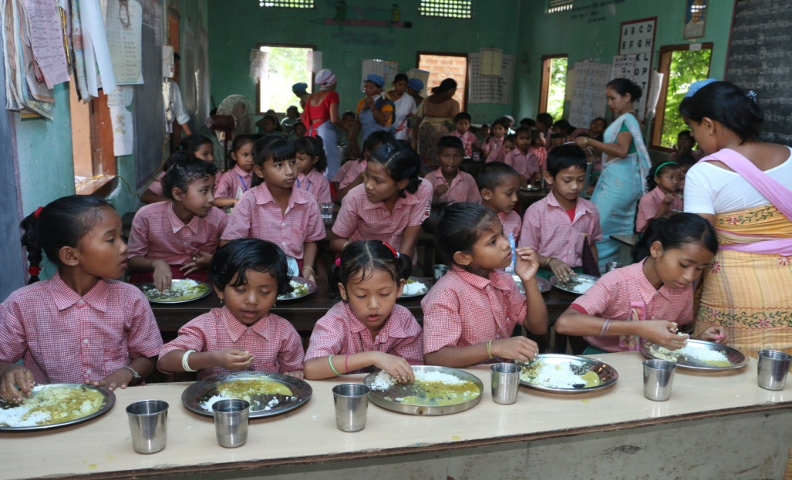
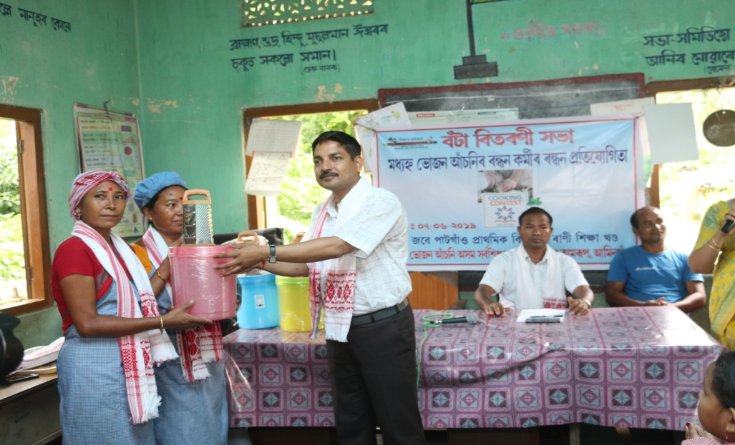
MDMS, Assam
Cooking Competition: Kamrup (Rural) District
1. Sajan Para LPS, 2. Jabe Patgaon LPS, 3. Andherijuli LPS
Cook cum Helpers participated- 6 ( 2 in each school)

Slide 25
MDMS, Assam
Cooking Competition: Dhemaji District
1. Borpathar Navajyoti ME School 2. Lakuachuk LP School , 3. Ba-Bapu LP School
Cook cum Helpers participated- 3 ( 1 in each school)

Slide 26
MDMS, Assam
Proposals during the financial year 2019-20:

Slide 27
MDMS, Assam
Proposal for FY 2018-19
(Rs. in lakh)
# | COMPONENT | Central Share | State Share | Total
Recurring
1 | COOKING COST | 39518.65 | 4419.41 | 43938.06
2 | HONORARIUM | 10709.82 | 1189.98 | 11899.80
3 | COST OF FOODGRAINS | 3033.25 | 0.00 | 3033.25
4 | TRANSPORTATION COST | 1375.07 | 0.00 | 1375.07
5 | MME | 1475.19 | 0.00 | 1475.19
Total Recurring |  | 56111.98 | 5609.39 | 61721.37
Non-Recurring
6 | Repair of Kitchen cum Store | 2607.12 | 289.68 | 2896.80
7 | Kitchen Devices | 4.23 | 0.47 | 4.70
Total Non Recurring |  | 2611.35 | 290.15 | 2901.50
Total [Recurring+Non Recurring] |  | 58723.33 | 5899.54 | 64622.87
8 | Flexi fund(5%) | 2642.55 | 293.62 | 2936.17
Grand Total[Recurring+Non recurring+Flexi] |  | 61365.88 | 6193.16 | 67559.04

Slide 28
MDMS, Assam
Repairing of Kitchen cum Stores
State has proposed to repair 28,968 Kitchen cum Stores (plinth area 10.80 sqm) @Rs.10,000/- per unit constructed prior to the financial year 2008-09 @Rs.60,000/- per unit.
Total estimated outlay of Rs.2896.80 lakh @Rs.10,000/- per unit, which comprises of Rs.2607.12 lakh as Central Share and Rs.289.68 lakh as State Share.
Proposed work to be done like plinth filling, floor toping, rise of wall and RCC post, replacement of roof, painting etc.

Slide 29
The Best Practices
MDMS, Assam
Utilisation of 5% Flexi Fund
Providing nutritious items.
Development of School Nutrition Garden
1
2

Slide 30
Flexi Fund
1. Development of School Nutrition Garden
State has proposed to develop School Nutrition Garden in 6,915 schools @Rs.5,000/- per school.
Total estimated outlay of 345.75 lakh @5,000/- per school, which comprises of 311.18 lakh as Central Share and 34.58 lakh as State Share.

Slide 31
Flexi Fund
2. Providing Nutritious Items
State has proposed to provide nutritious item like banana to all 40,51,337children in 32 days in a year (one day per week for 32 weeks approx).
Total estimated outlay of 2590.42 lakh @Rs.2/- per child per day (Rs.64/- per child per year), which comprises of 2331.37 lakh as Central Share and 259.05 lakh as State Share.

Slide 32
Weekly Menu (suggested) under MDM Scheme, Assam
Day | Item
Monday | Rice, Dal, Leafy Vegetables
Tuesday | Khisidi/ Soya, Leafy Vegetables
Wednesday | Rice, Egg Curry/ Local option/Leafy Vegetables
Thursday | Rice, Dal, Leafy Vegetables
Friday | Rice, Dal, Leafy Vegetables
Saturday | Khisidi/ Pulao/Local option/Leafy Vegetables

Slide 33
Operational Issues with prior approval from the Chair

Slide 34
Operational Issues:-
Non enhancement of the honorarium of Cook cum Helpers since December, 2010 due to which the Association of cook cum helpers frequently stage protest/dharna which hamper the smooth implementation of the scheme.
No provision of dining hall in the schools due to which children taking MDM in the school verandah/classroom.

Slide 35
Thank you

